Slide 1
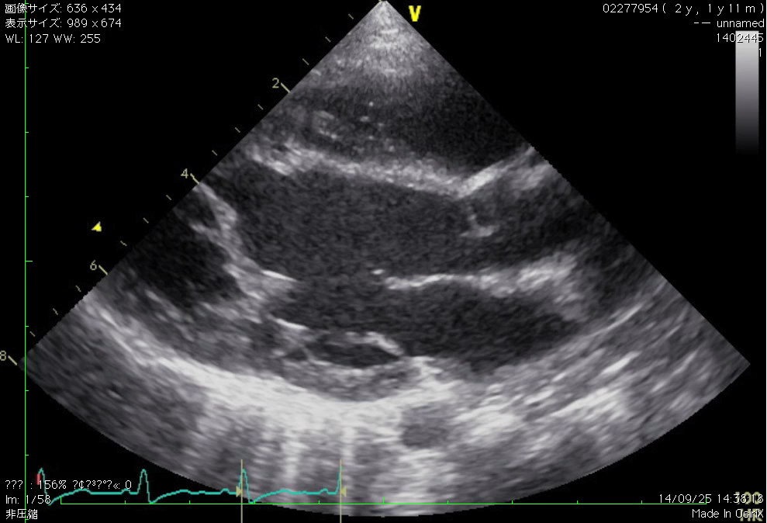
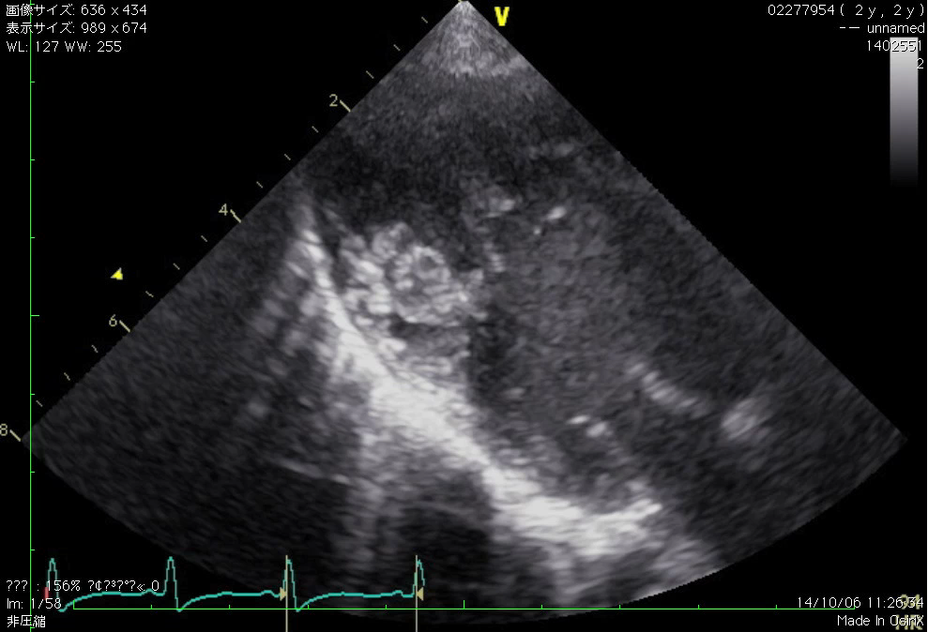
Fig.1 Preoperative echocardiography
A: At admission B: 10 days after admission
LV partition wall
Apical chamber
Apical chamber
Outlet chamber
LV thrombus
Outlet chamber
Mitral apparatus
LV partition wall
A
B

