Slide 1
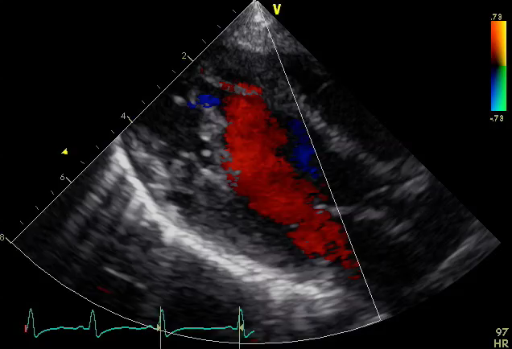
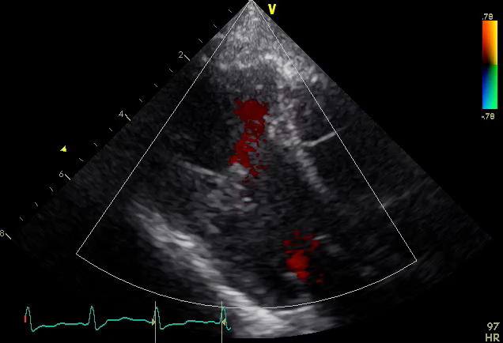
Fig.3 Perioperative echocardiography A: Pre operative echo showed a narrow communication between 2 chambers in the left ventricle. B: Echocardiography 1 week after surgery C: Echocardiography 9 months after surgery showed a wide communication as seen at immediately after surgery.
<Pre ope＞
＜Post op＞
LV partition
Apical chamber
Outlet chamber
A
C
＜Post ope＞
Remnant of
the partition
B

