Slide 1
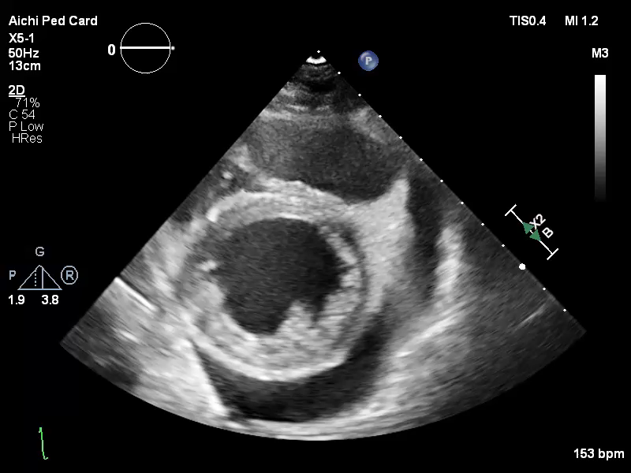
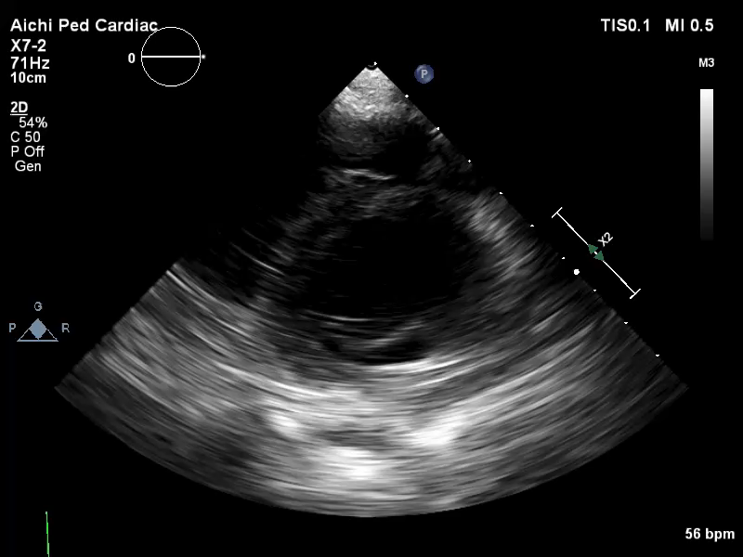
Movie 1: Echocardiographic findings of myocarditis in our cases.
A.
B.
A) A typical case of fulminant myocarditis with decreased left ventricular contractility, myocardial edema, and pericardial effusion.
B) A case of fulminant myocarditis with preserved left ventricular systolic function and atrioventricular conduction disorder.

Slide 2
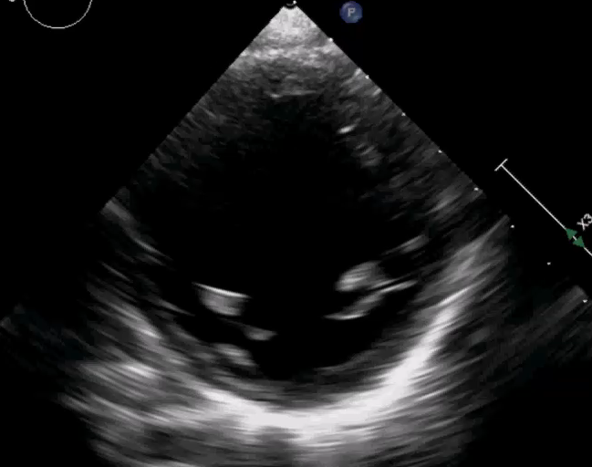
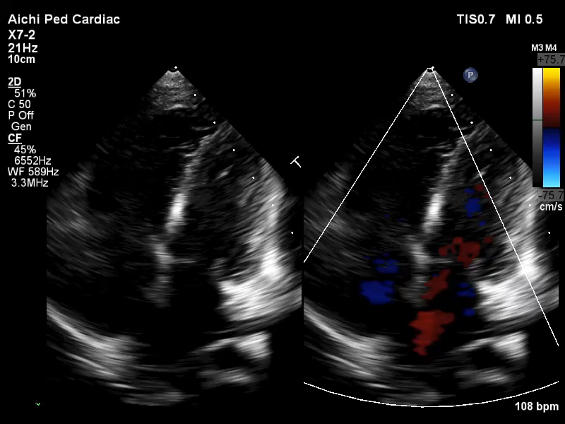
Movie 1: Echocardiographic findings of myocarditis in our cases.
C.
D.
C) A case showing left ventricular dilatation, wall thinning, and decreased left ventricular contraction. Initially, this case was clinically diagnosed with dilated cardiomyopathy, and later diagnosed with acute myocarditis by myocardial biopsy.
D) A rare case of right ventricular dominant myocarditis.

